Slide 1
wikilab
UFABC – São Bernardo do Campo, Brazil

Slide 2
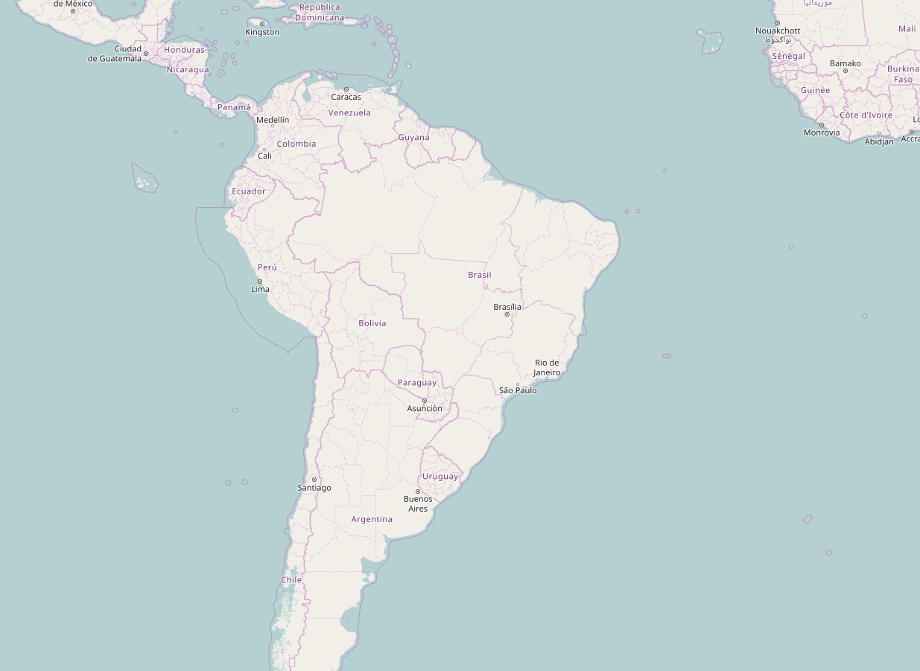
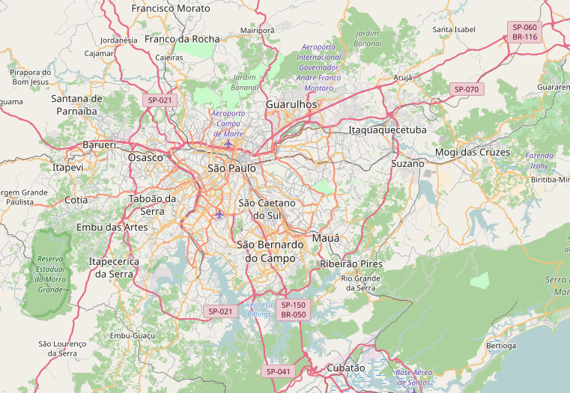
São Bernardo do Campo,
part of the São Paulo metropolitan area

Slide 3
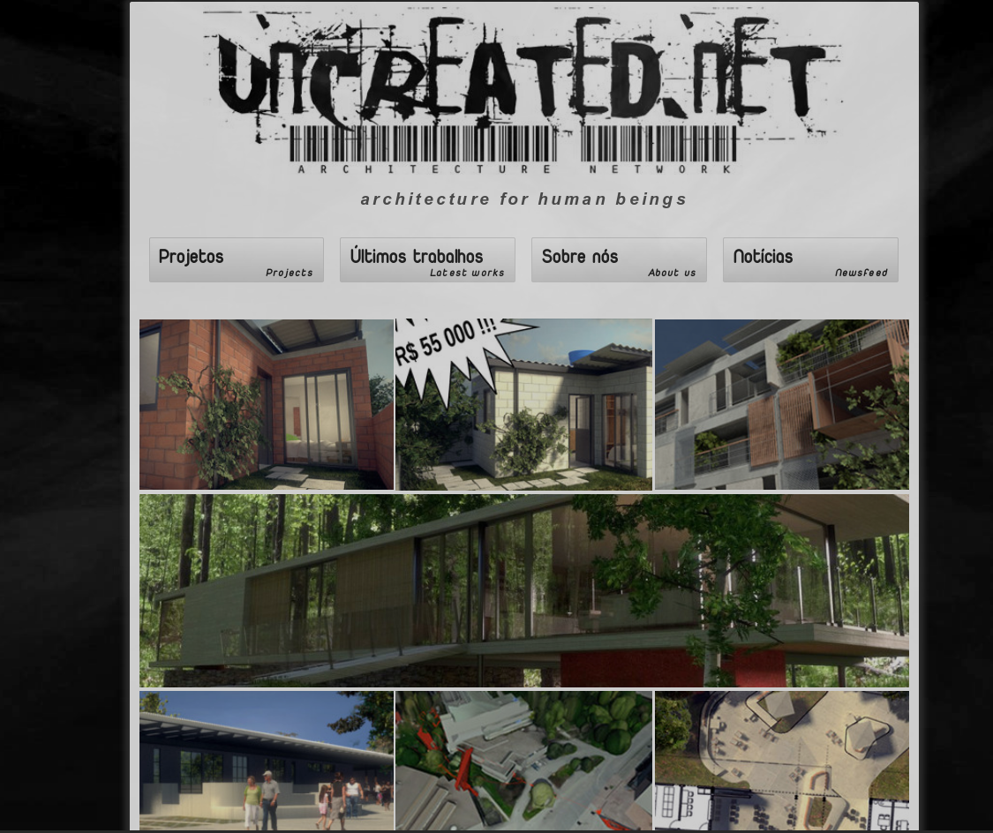
Our arch studio!
http://www.uncreated.net

Slide 4
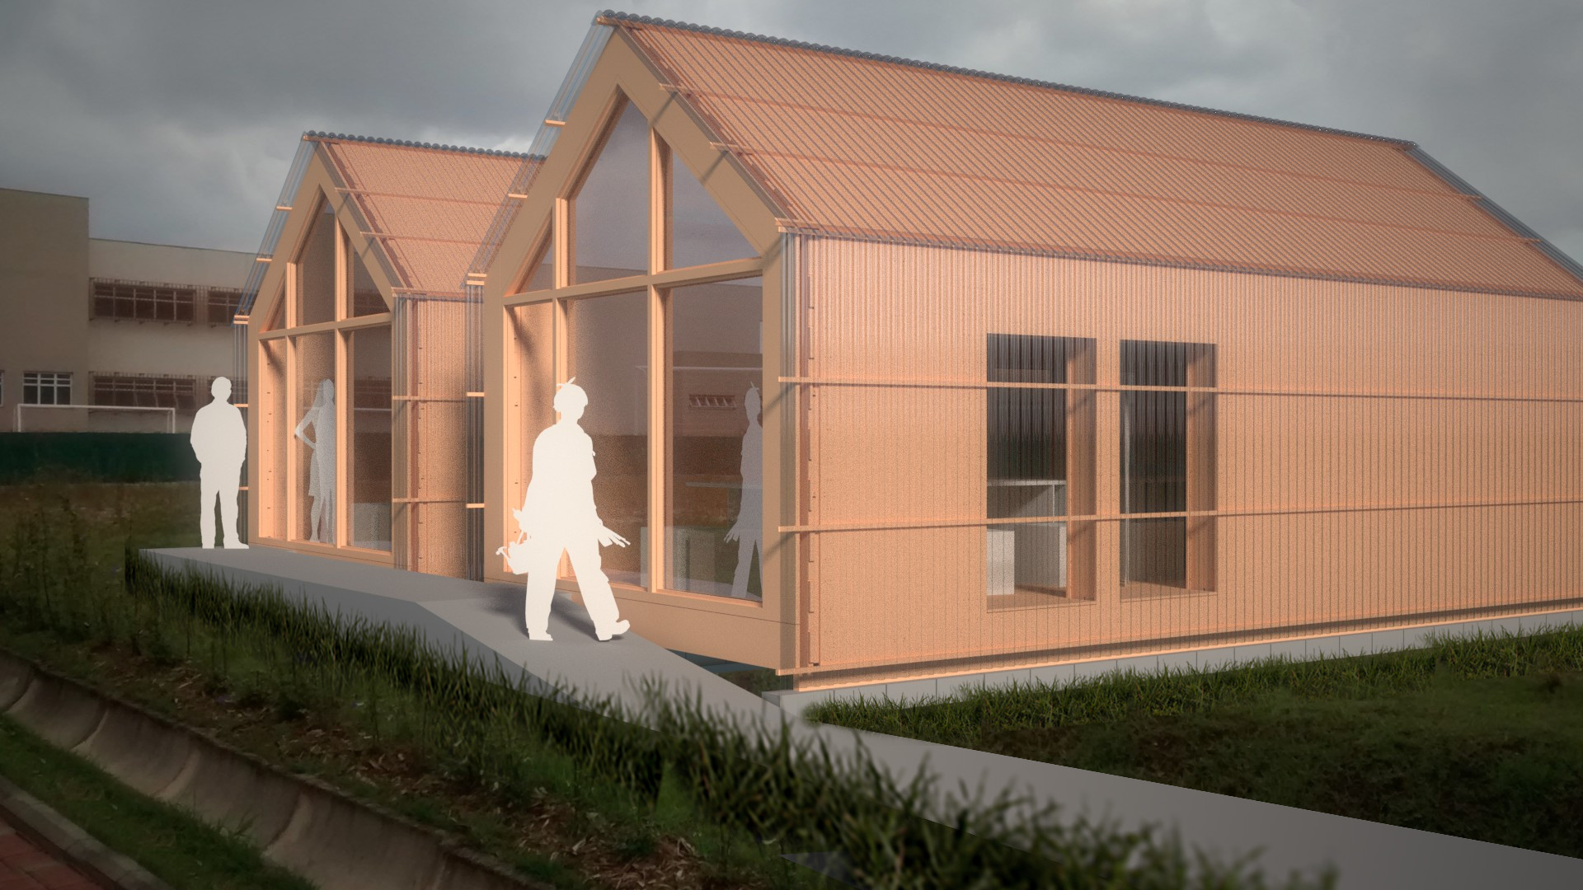

Slide 5
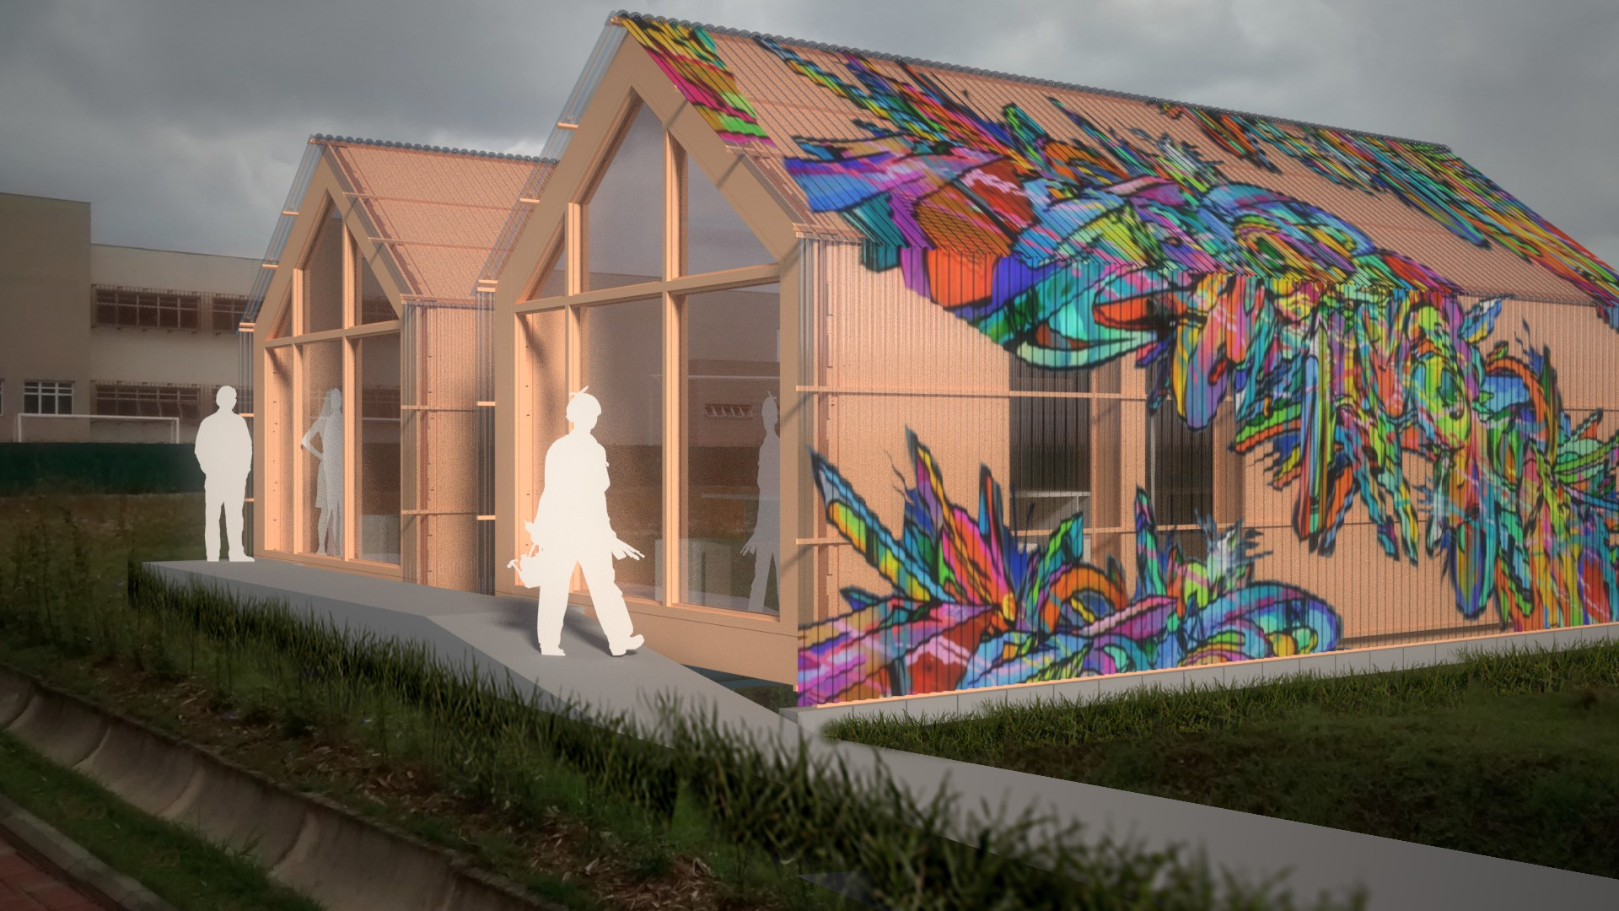

Slide 6
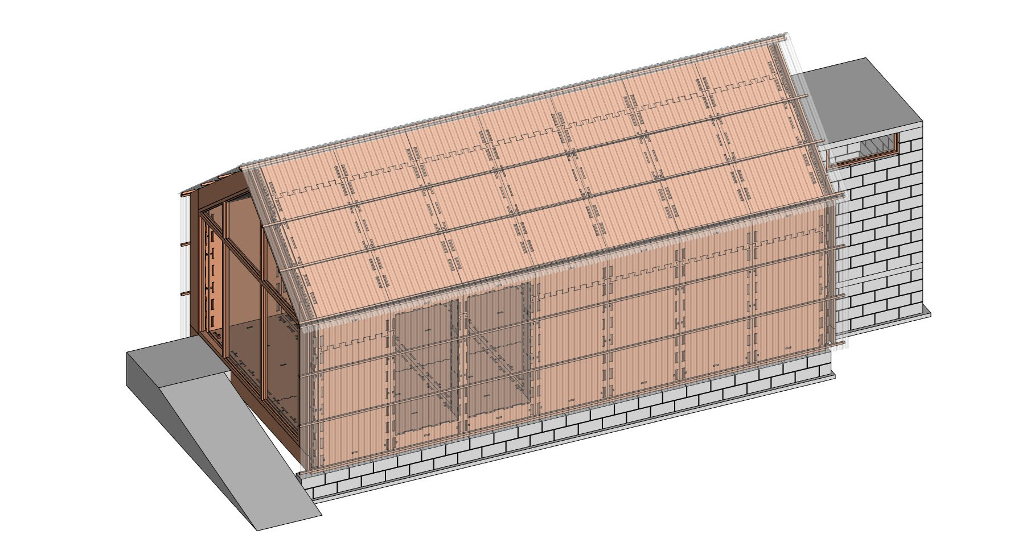
1. CMU base
2. WikiHouse construction
3. Polypropylene or polycarbonate cover

Slide 7
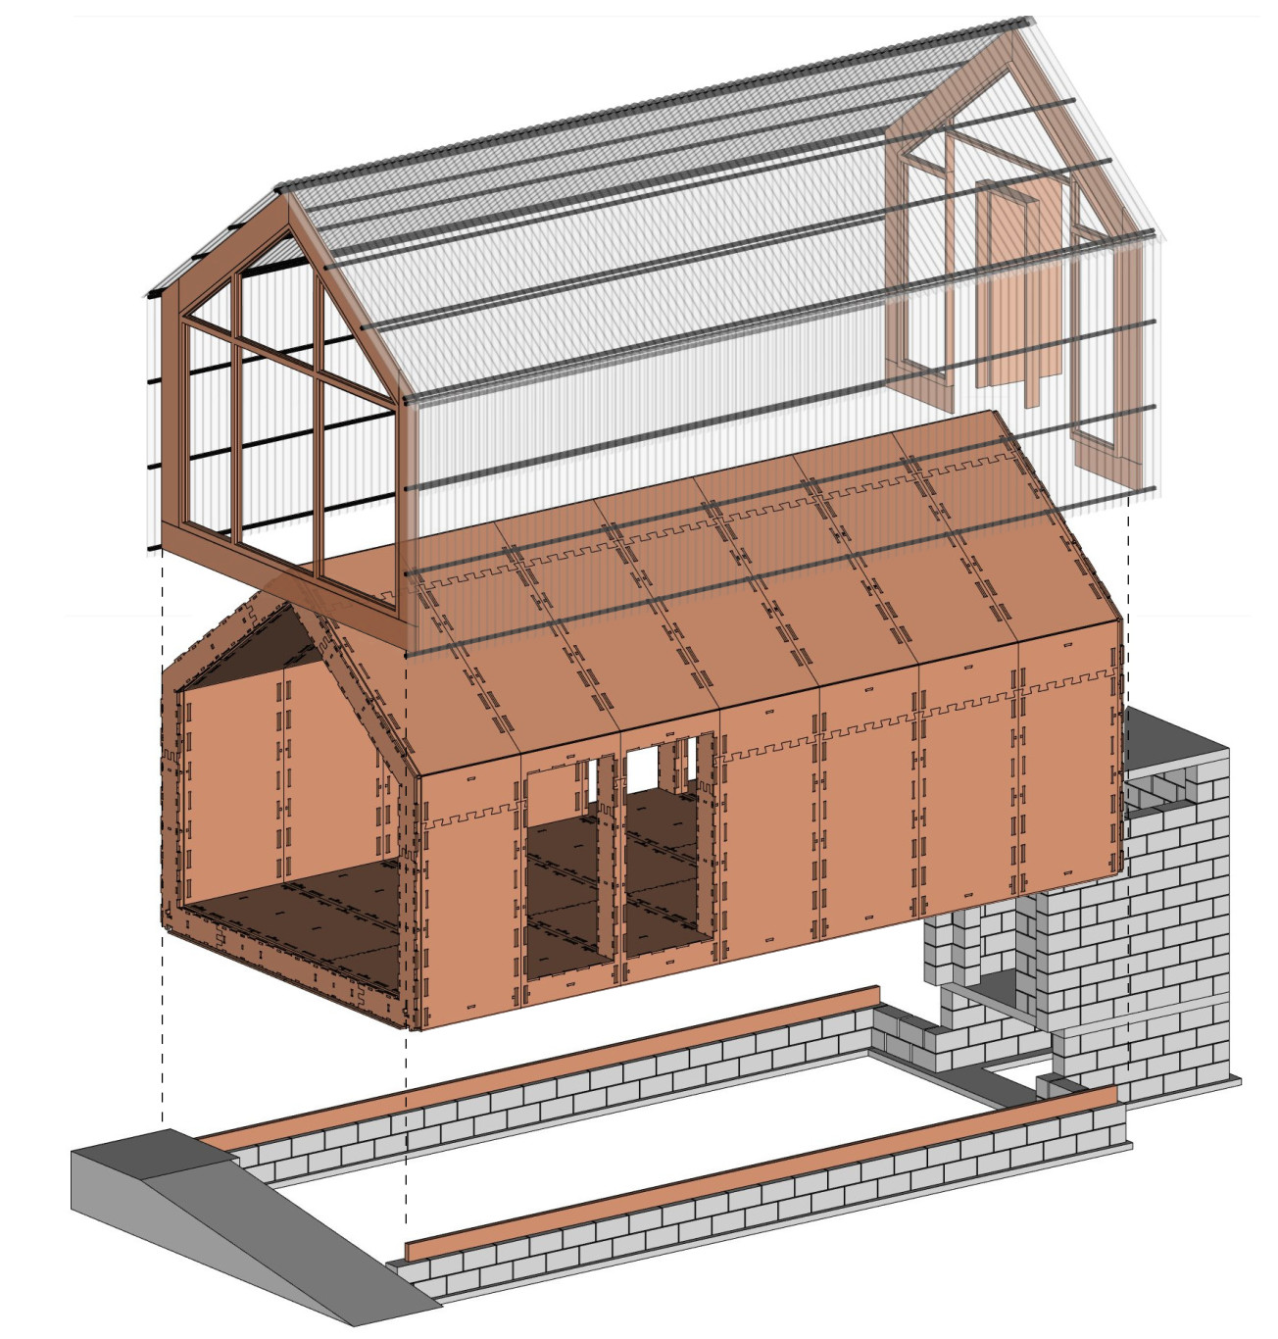

Slide 8
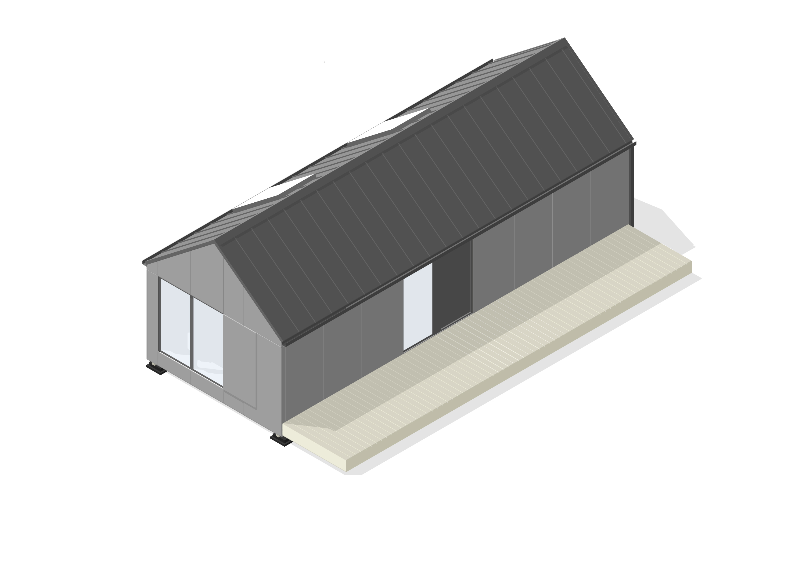
WikiHouse’s MicroHouse

Slide 9
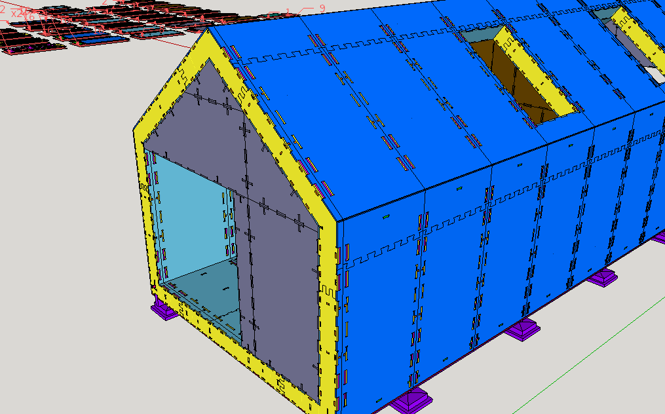
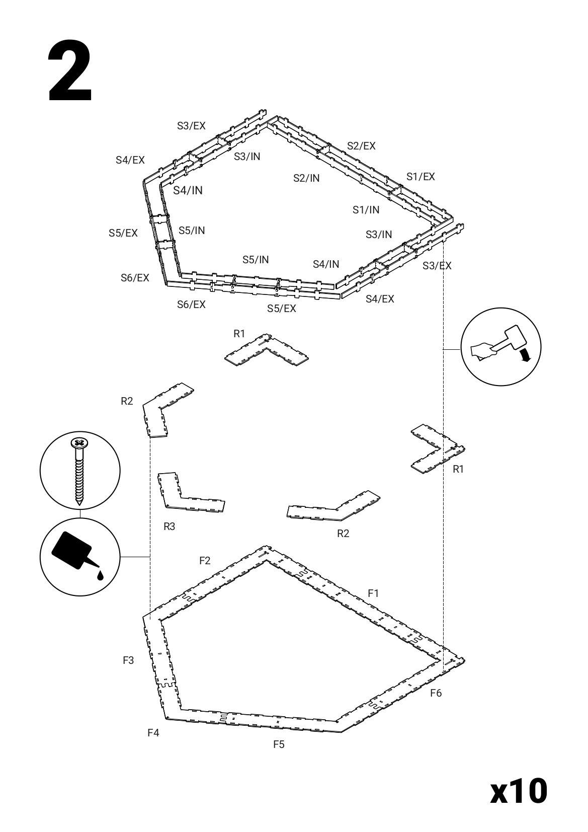
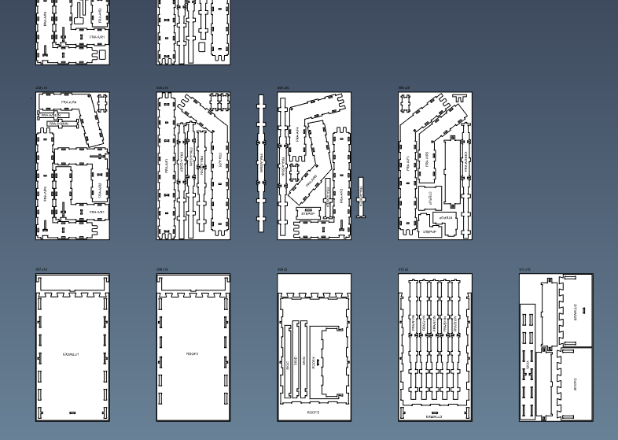

Slide 10
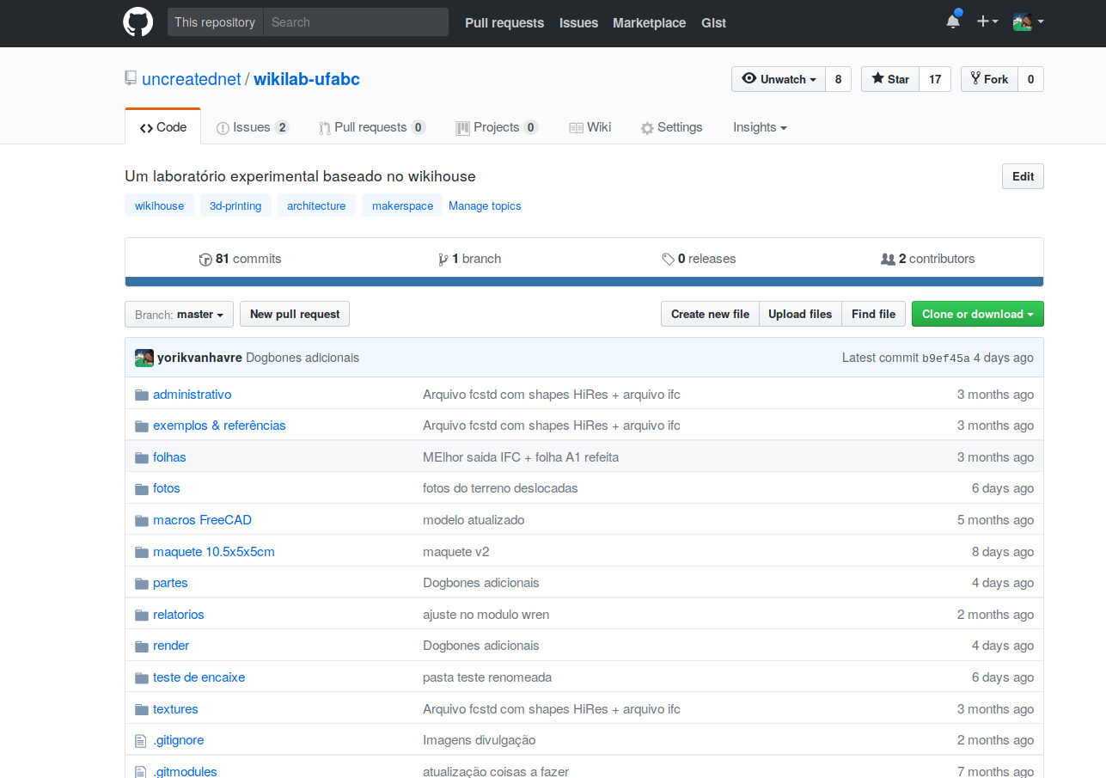
https://github.com/uncreatednet/wikilab-ufabc

Slide 11
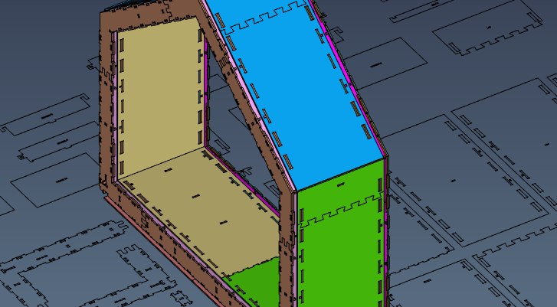
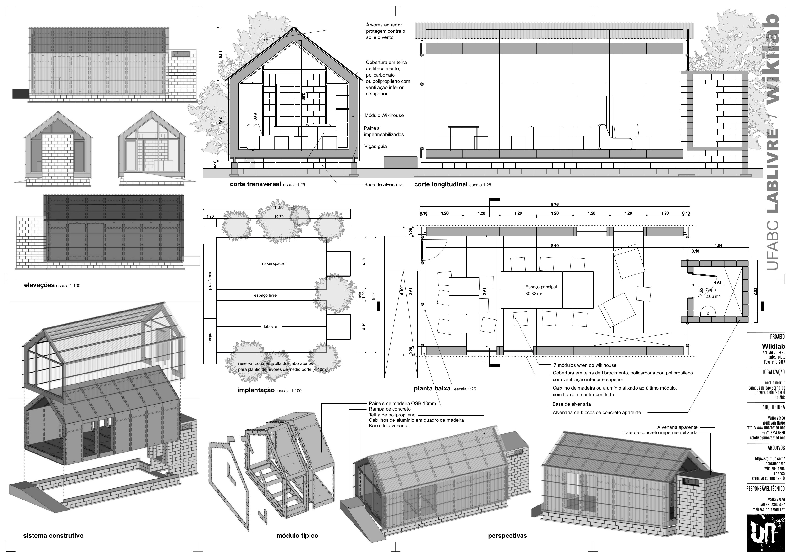
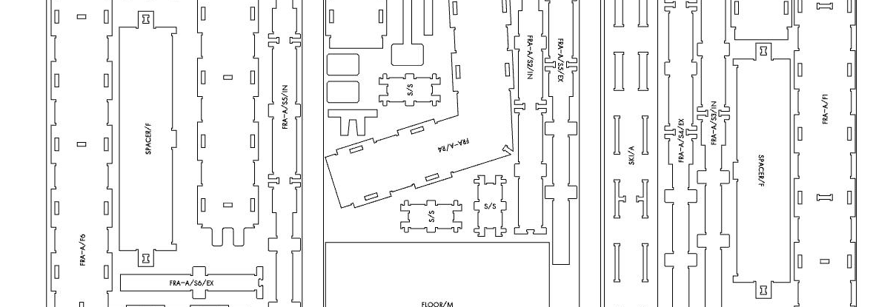
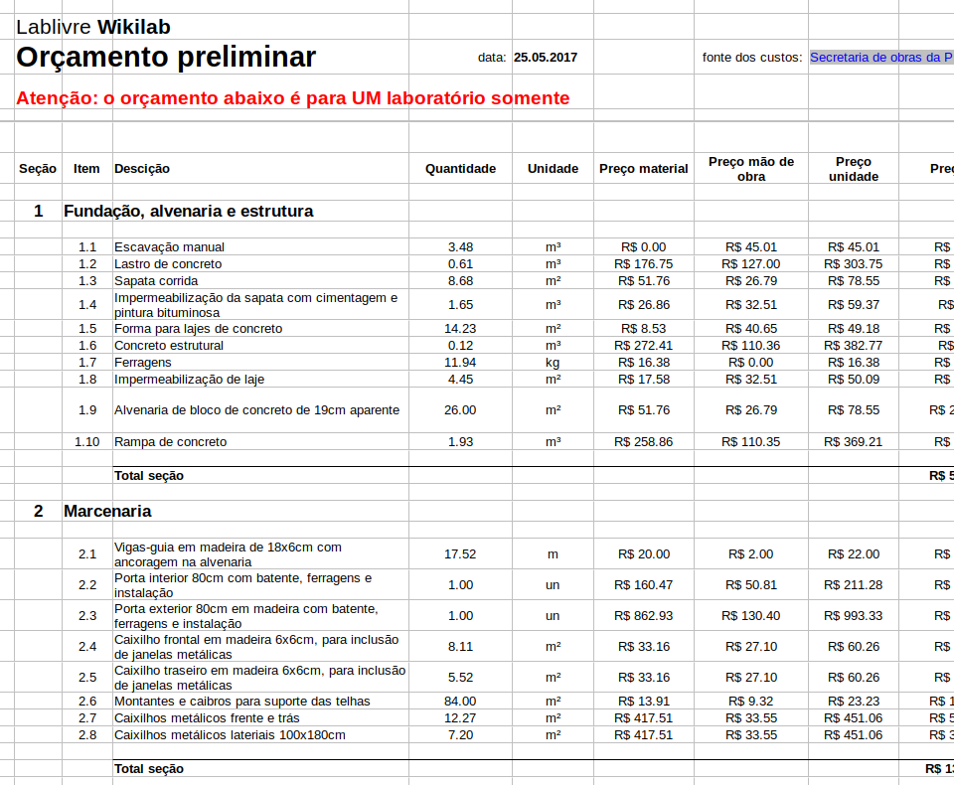
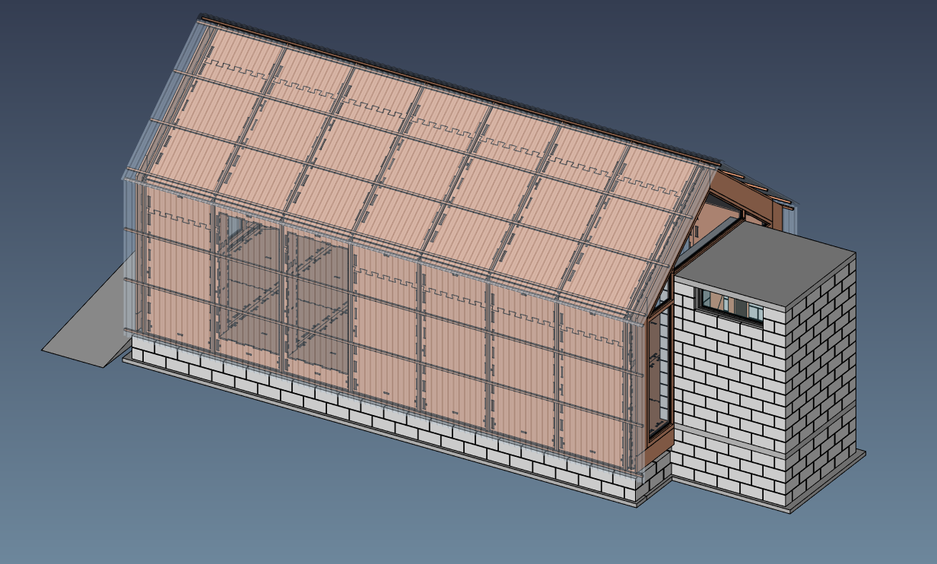
All the files are there

Slide 12
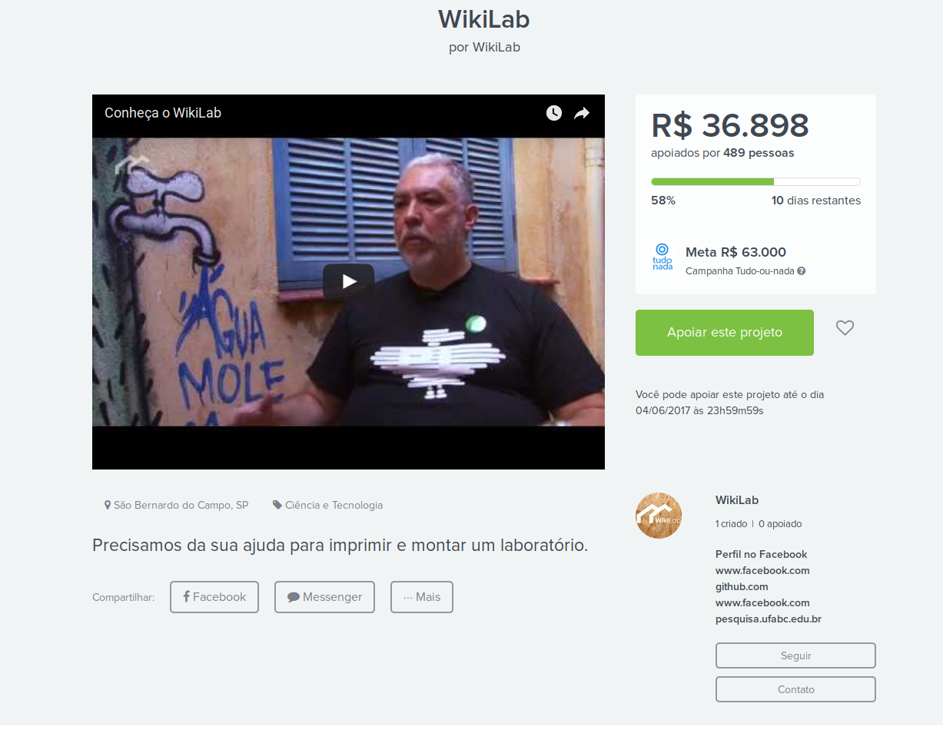
https://www.catarse.me/wikilab

Slide 13
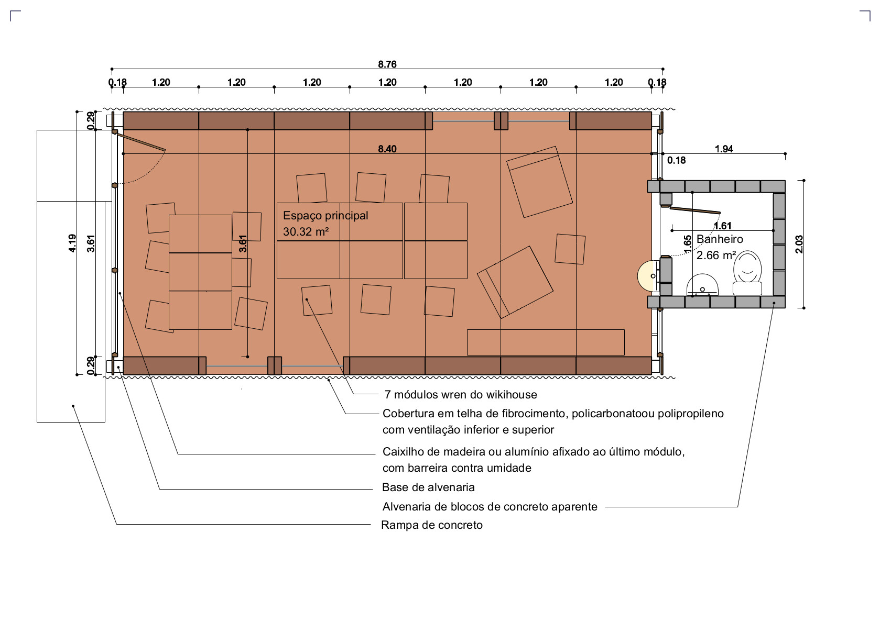
All hydro equipment & piping moved out of the wooden part
Not 100% tight joints not a problem

Slide 14
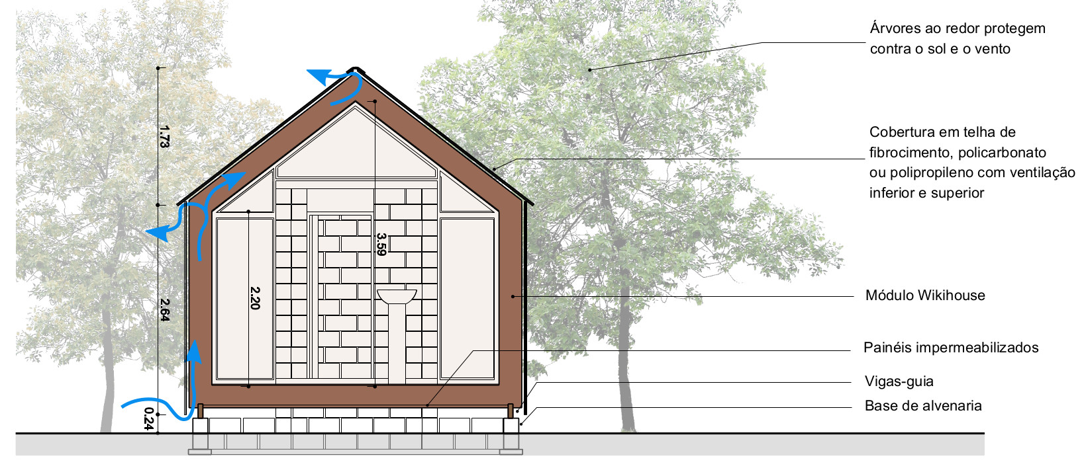
Permanent ventilation between the WikiHouse components and the outer skin

Slide 15
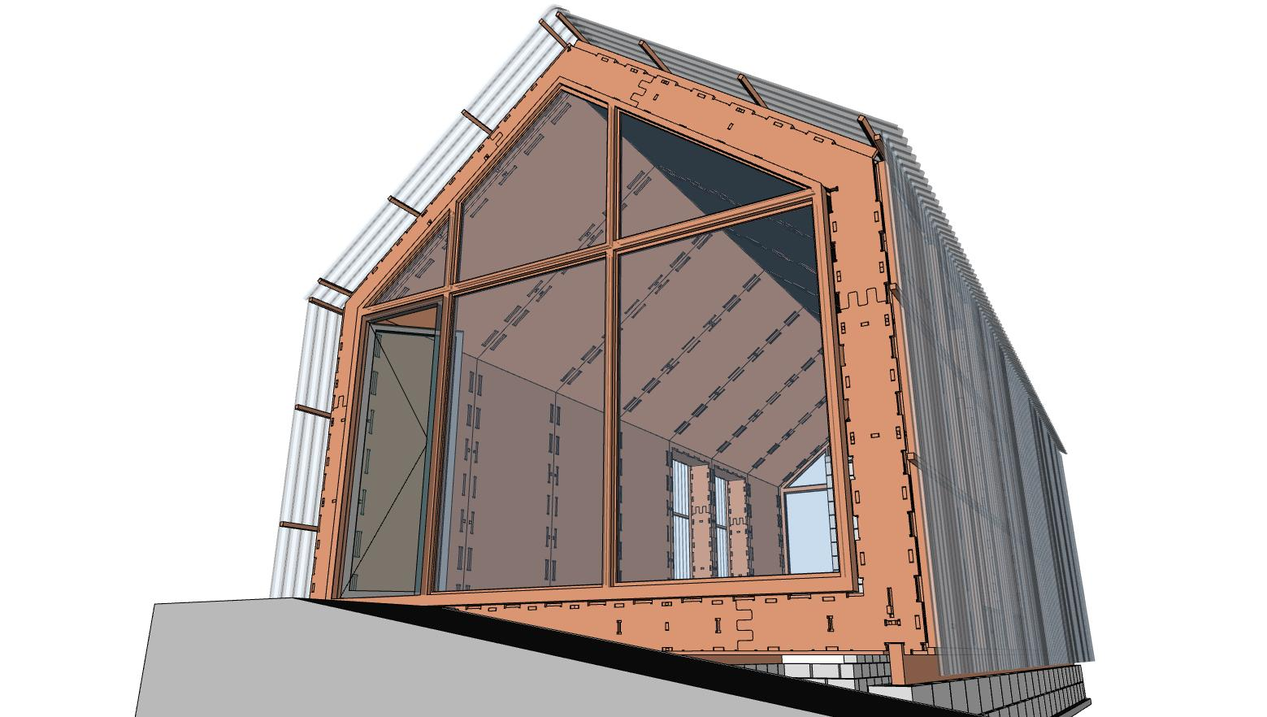

Slide 16
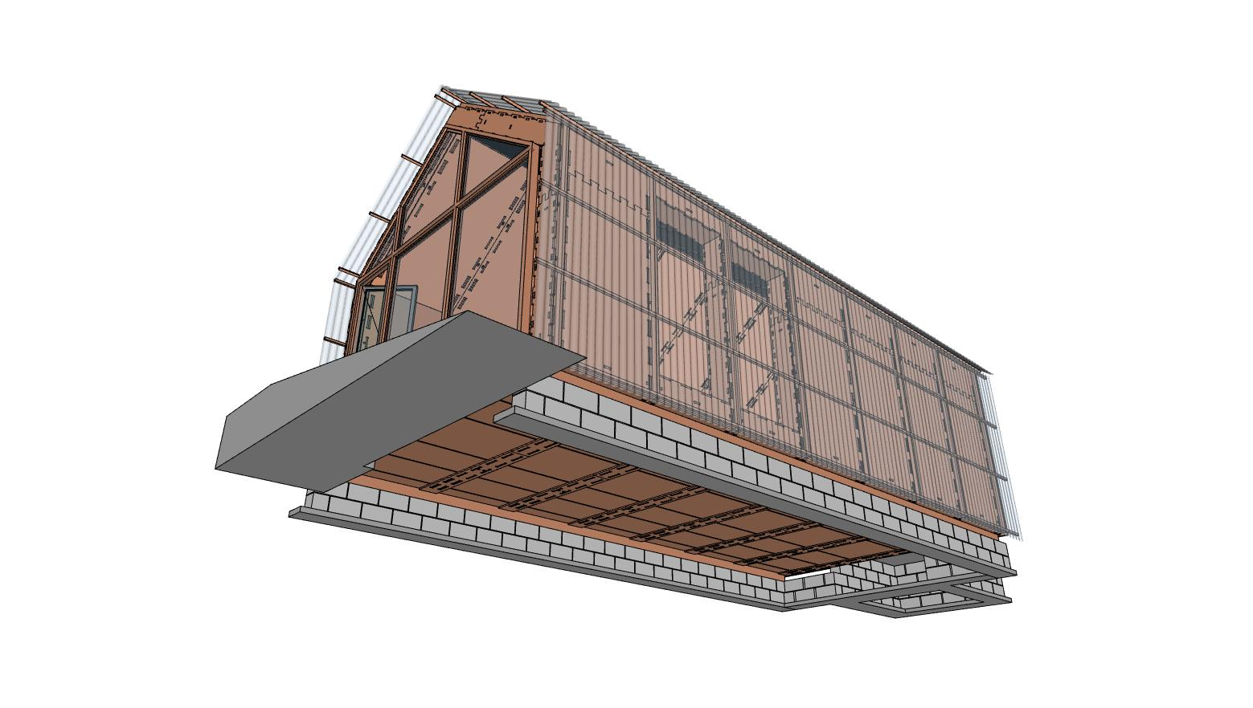

Slide 17
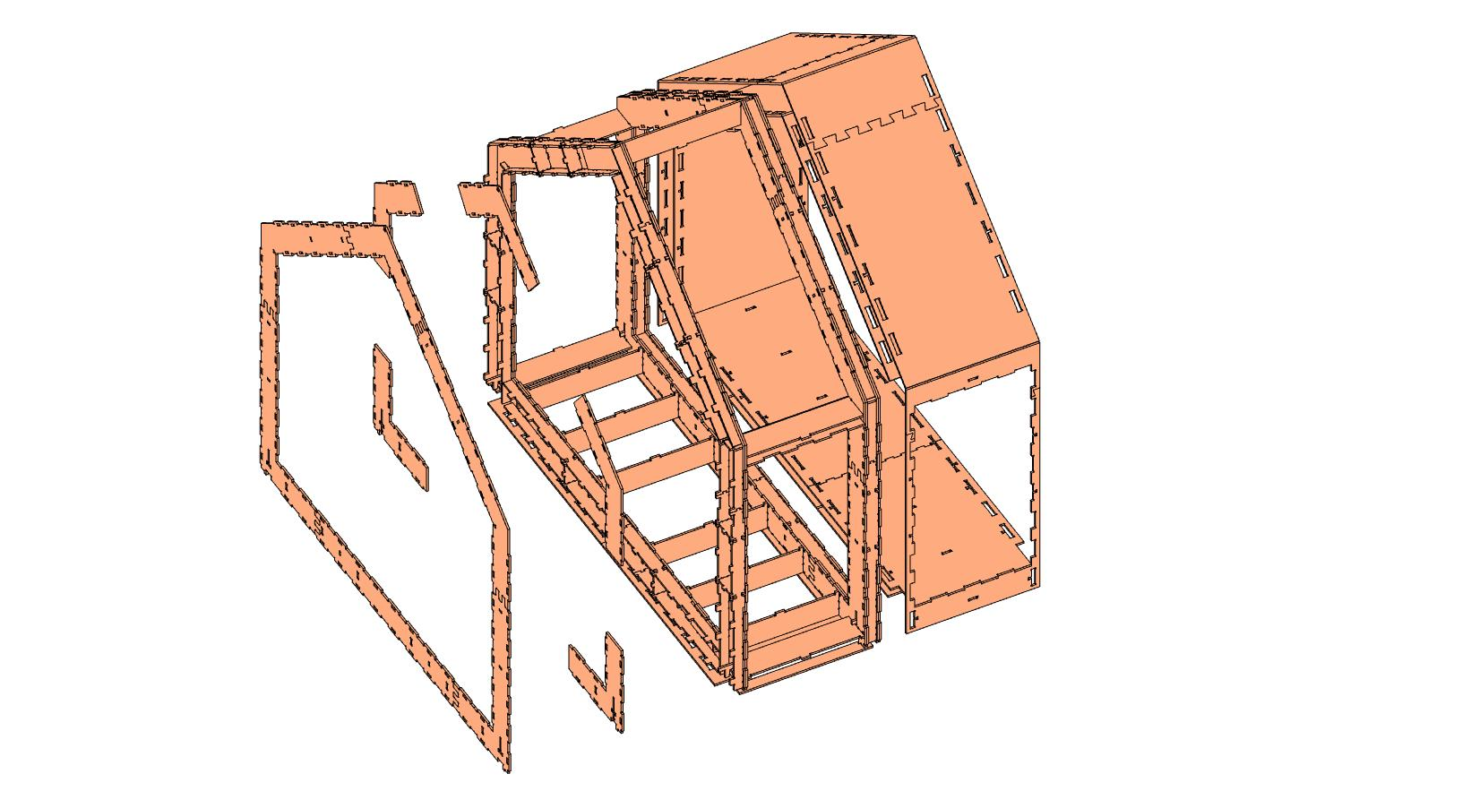
The WikiHouse Wren module, unchanged

Slide 18
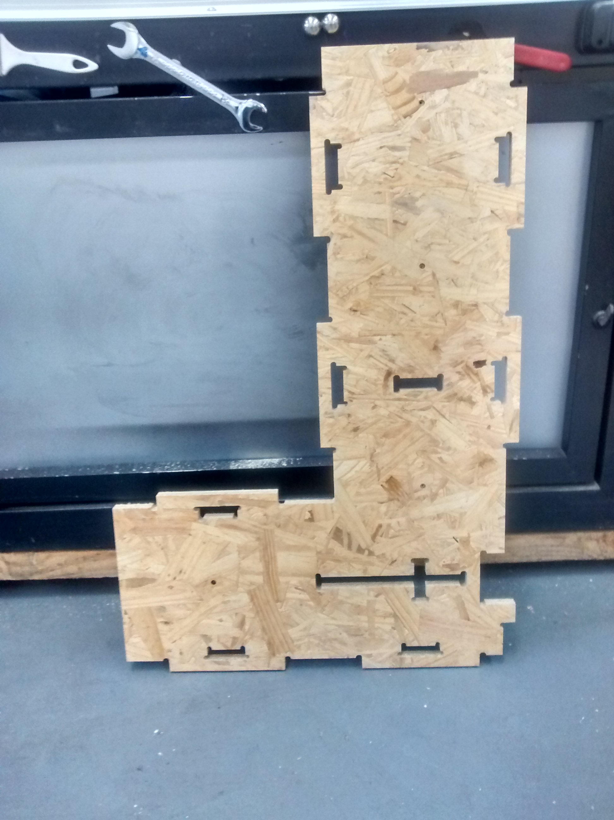
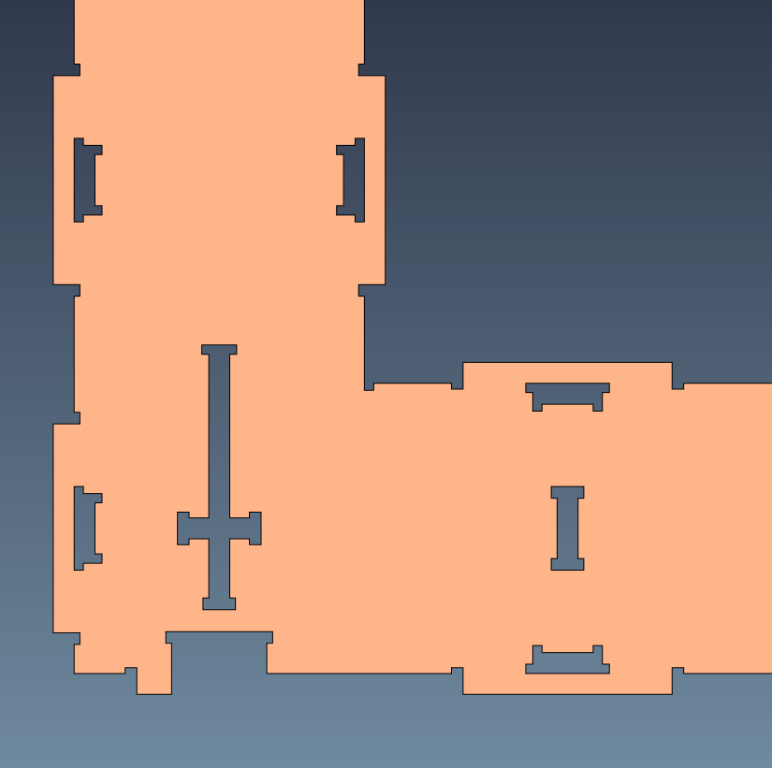
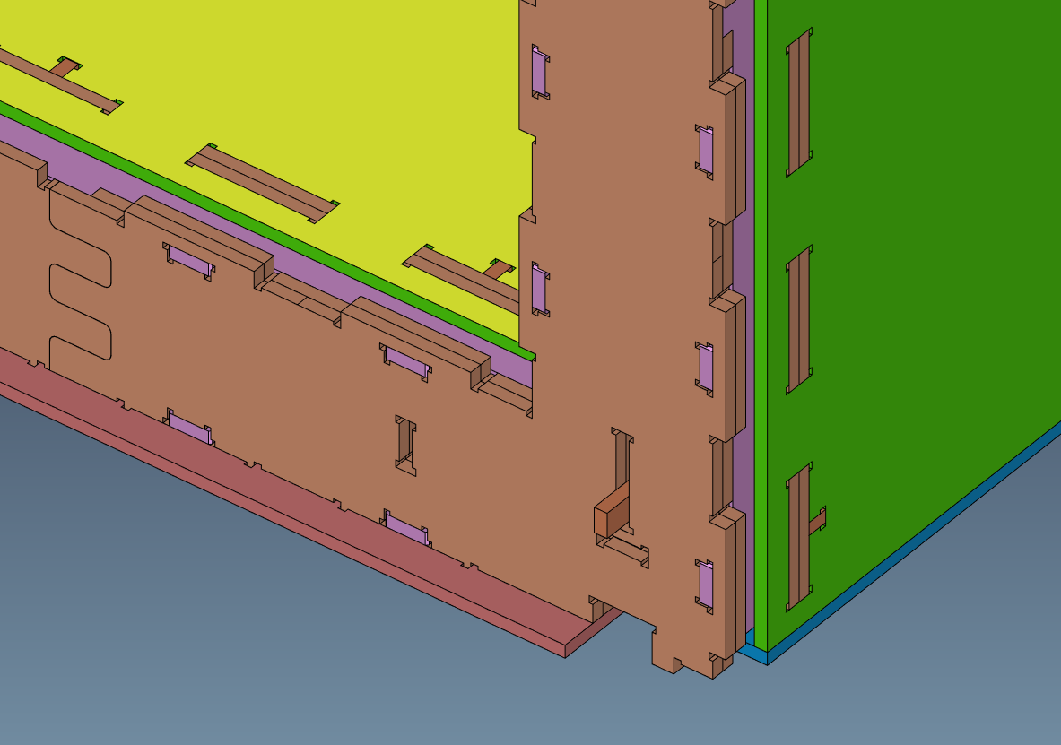
Small fixes (adding dogbones)

Slide 19
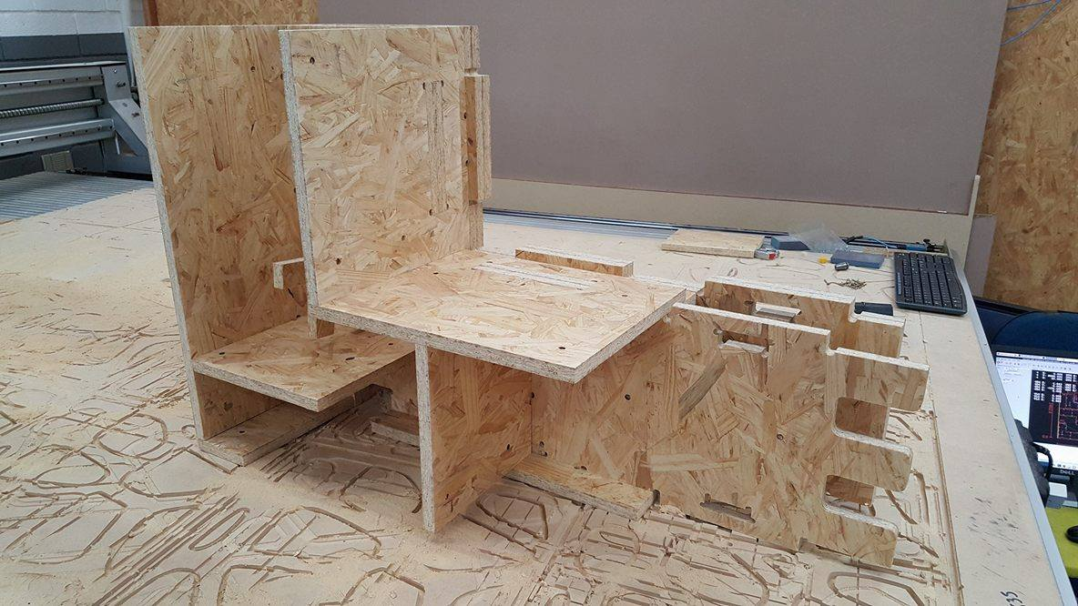
First test to calibrate the machine and check how OSB panels behave

Slide 20
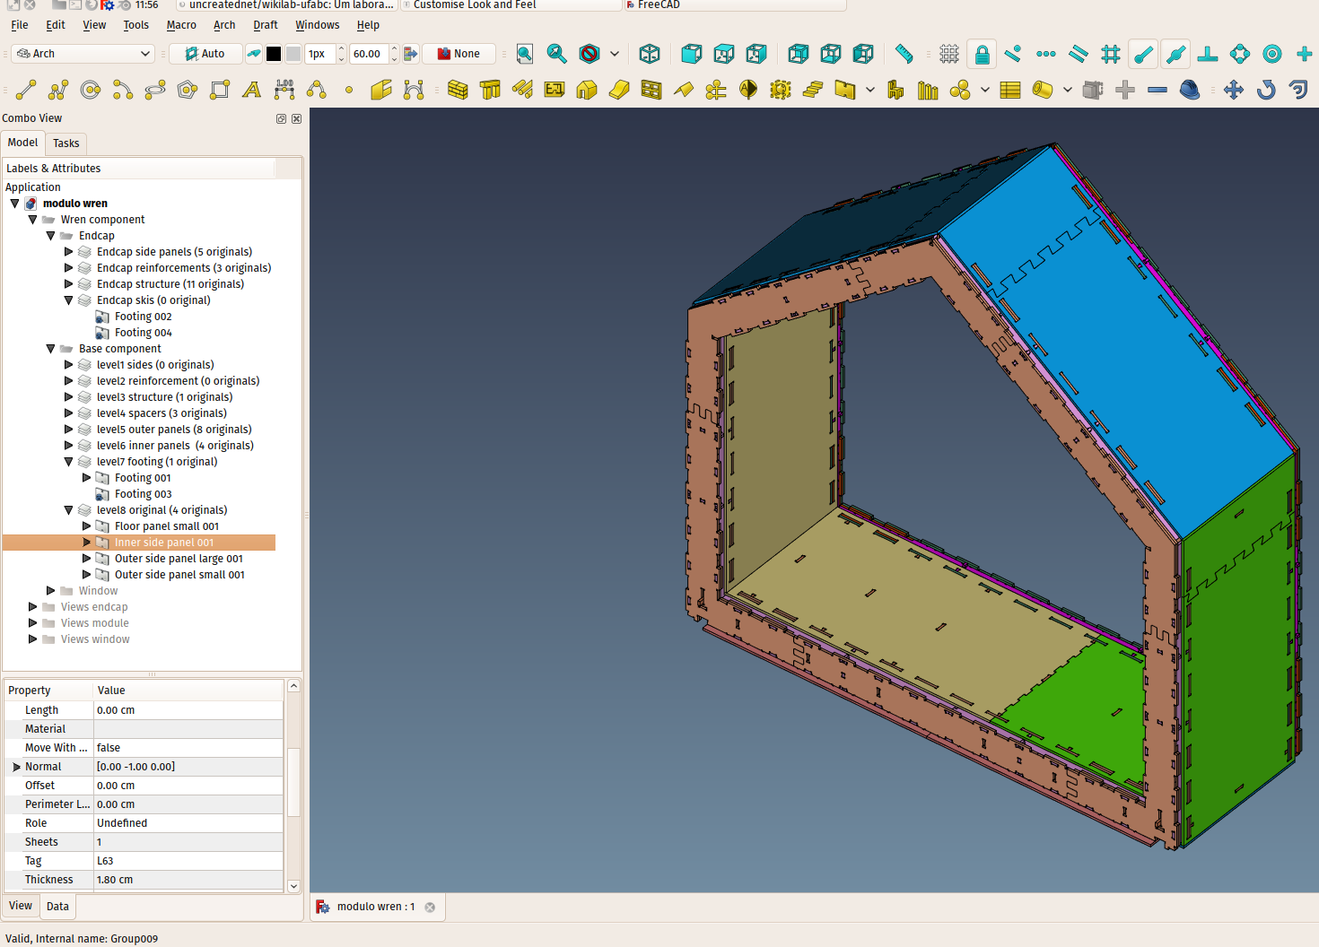
The main work file in FreeCAD

Slide 21
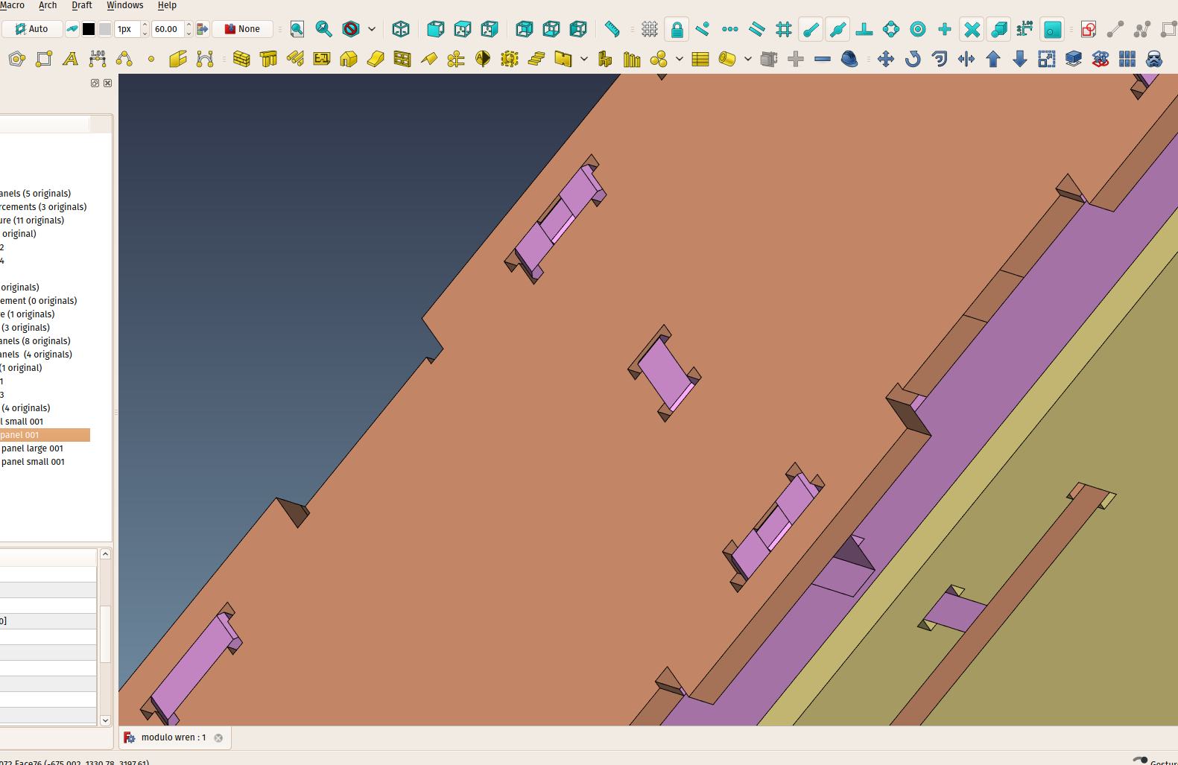
Small fixes needed here and there

Slide 22
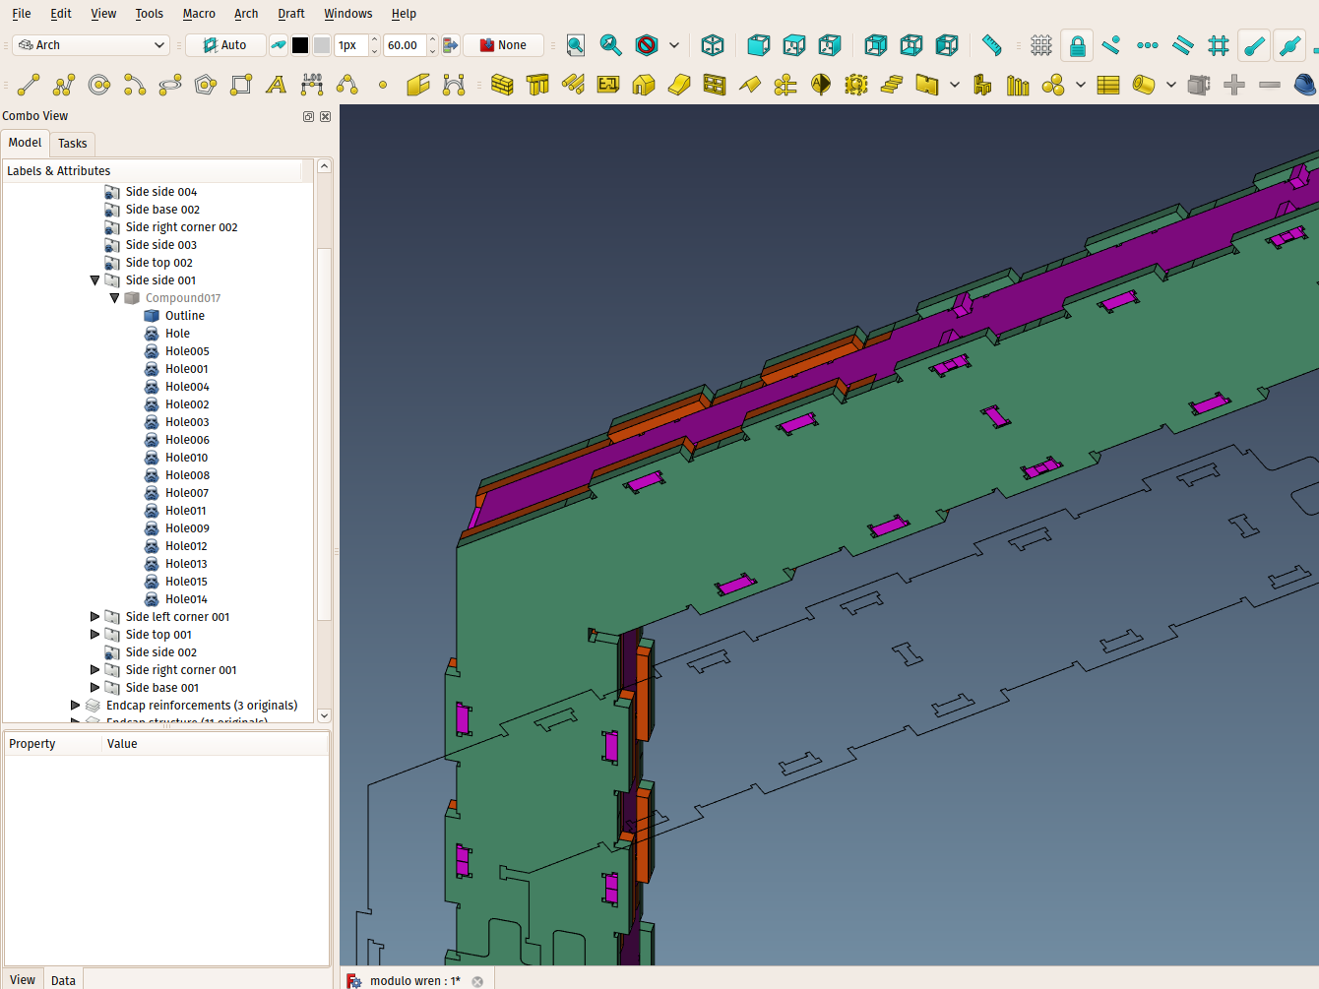
Holes are parametric, easy to modify

Slide 23
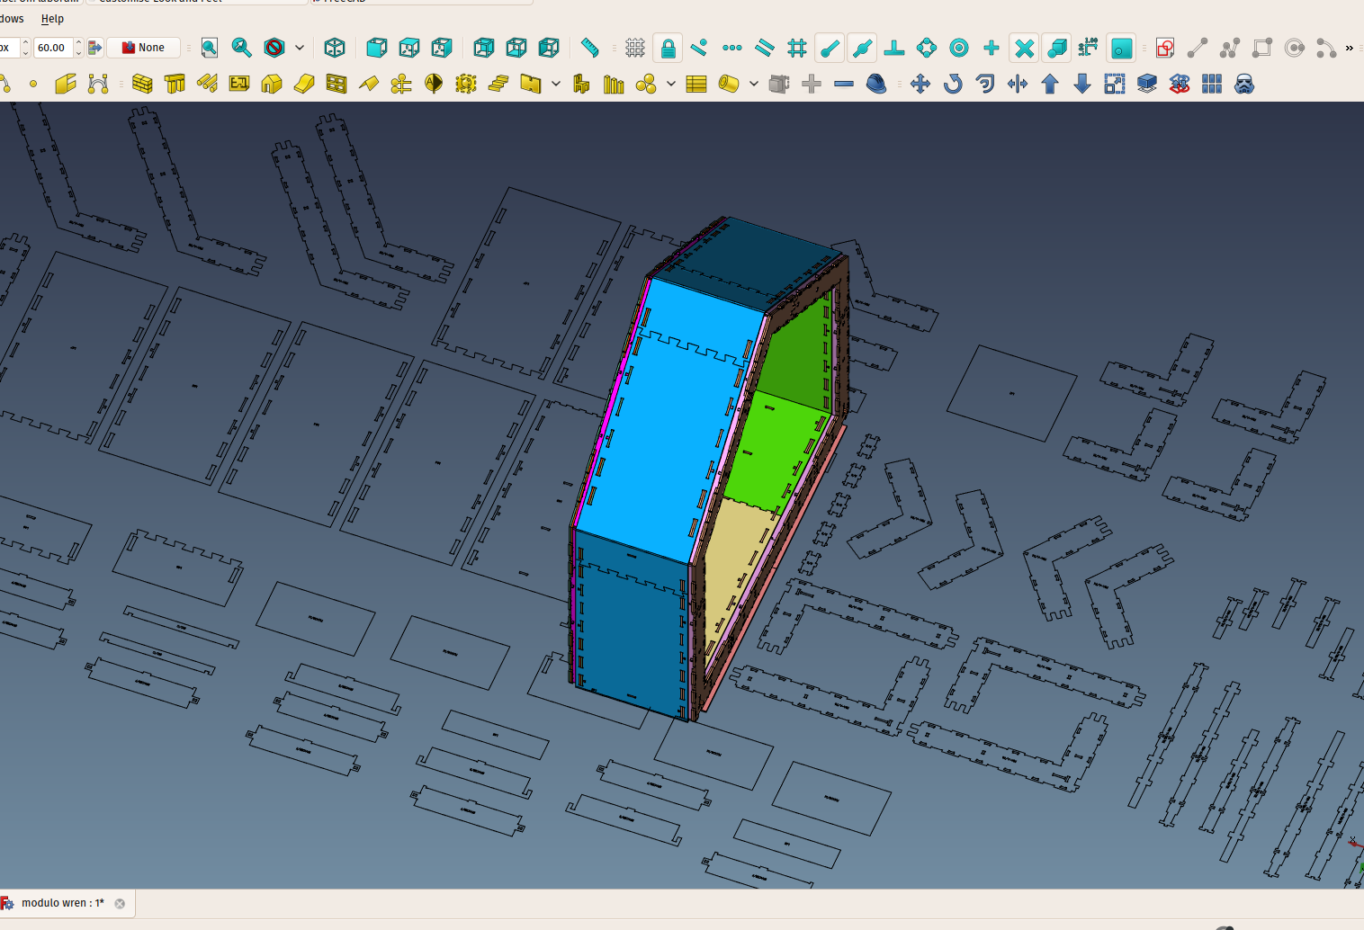
Generating cut sheets

Slide 24
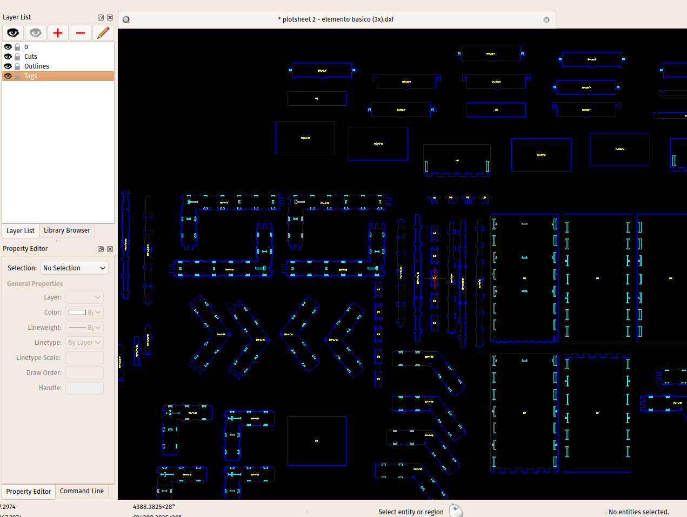

Slide 25
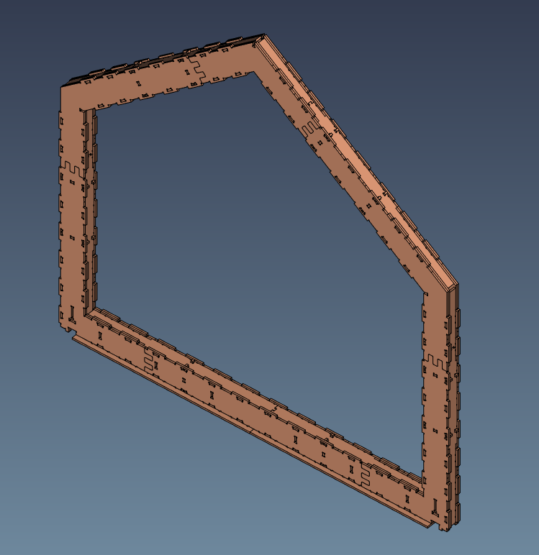
Tomorrow job!

Slide 26
https://github.com/uncreatednet/wikilab-ufabc
https://www.facebook.com/wikilab.abc
https://www.catarse.me/wikilab
http://www.uncreated.net/

